Slide 1
Delivery Drone
By Jonathan Rayo, Peter Surlina, Fidel Herrera

Slide 2
Introduction
COVID-19 has caused negative effects on our society and the economy.
The U.S. Department of Health and Human Services Office for Preparedness and Response stated that COVID-19 has disrupted the supply chain globally.
The Centers for Disease Control and Prevention advised to avoid contact with infected people, as well as crowds.
Our goal was to implement a delivery drone system to mitigate the spread of COVID-19.

Slide 3
Problem Statement
Manufacturers such as Amazon and UPS have their own delivery drones, which are too expensive for small business implementation.
Our drone was built from custom parts to significantly decrease costs and encourage aspiring drone users
A previous group’s drone frame was used which also helped to decrease costs and reduce waste
Aimed towards small business use and hobbyists

Slide 4
Economic and Environmental Impact
Economic impact
Economically, this project helps decrease the manufacturing cost of drones to a realistic level. Not everyone will have the resources that major corporations have. This project enables an alternative option to try something different or enhance their small business.
Environmental impact
Keeping batteries at a fully charged capacity at elevated temperatures is the worst-case scenario. It is better to have lower charged voltages to prolong battery life. This will ensure the longevity of the delivery drone while reducing hazardous waste
Fossil fuels are reduced as battery power is used rather than fuel.

Slide 5

Societal and Global Impact
Societal impact
Alleviate local spread of COVID-19 through contactless delivery
Assists small business owners in delivering goods
Global impact
The spread of COVID-19 is decreased globally as contactless delivery mitigates potential spreading of the disease.

Slide 6
Engineering Standards
IEEE standards considered
IEEE 1901 standard states “Charging communication: IEEE 1901 provides broadband over powerline communications to be used in charging electric vehicles (EVs), and IEEE 2030.1.1 on DC quick charging”. This standard is honored by charging the battery with the balance charger
IEEE 1512.1-2006, IEEE Standard for Common Traffic Incident Management Message Sets for Use by Emergency Management Centers. This standard is honored through the manual override subsystem. In case of traffic incident, the user can take charge of the drone and land the drone to safety.
IEEE 1936.1-2021, IEEE Standard for Drone Applications Framework. Drone software was used with the flight controller which follows these standards and the team will follow the standard when designing the automatic delivery subsystem.

Slide 7
Ethics
One unfortunate impact of the delivery drone is that it can take away jobs from delivery drivers. This may be frowned upon because for some people, that is their livelihoods and how they make ends meet. However, the benefit of reducing the amount of delivery drivers emitting gas from their vehicles outweighs the negatives this presents.
Risk of interference with other objects. Whether that may be birds, UAVs, etc. there is a risk of causing damage to property or people. The delivery drone’s design to include a manual override via the RC controller adds an extra layer of protection from accidents.

Slide 8
Budget
Item | Quantity | Cost per item | Total cost per item
2 Sets Digital Load Cell Weight Sensor + HX711 ADC Module Weighing Sensor for Arduino DIY Portable Electronic Kitchen Scale Kit (5kg, HX711)l | 2 | $13.99 | $27.98
Pixhawk PX4 + Power Module + GPS Module | 1 | $256.00 | $256.00
Propellers | 1 set | $12.00 | $12.00
Battery | 1 | $45.00 | $45.00
Flysky FS-i6X 6-10(Default 6)CH 2.4GHz AFHDS RC Transmitter w/ FS-iA6B Receiver | 1 | $69.99 | $69.99

Slide 9
Constraints
Time for development was limited as the Pixhawk was delivered in late February
This meant half of the semester we were unable to test hardware configurations and flight
Budget had to be kept low to keep the drone at an affordable cost
Testing could only be performed outdoors in open areas
Test flights delayed due to bad weather conditions
Multiple crashes upon initial testing meant we had to fix drone parts that had broke

Slide 10
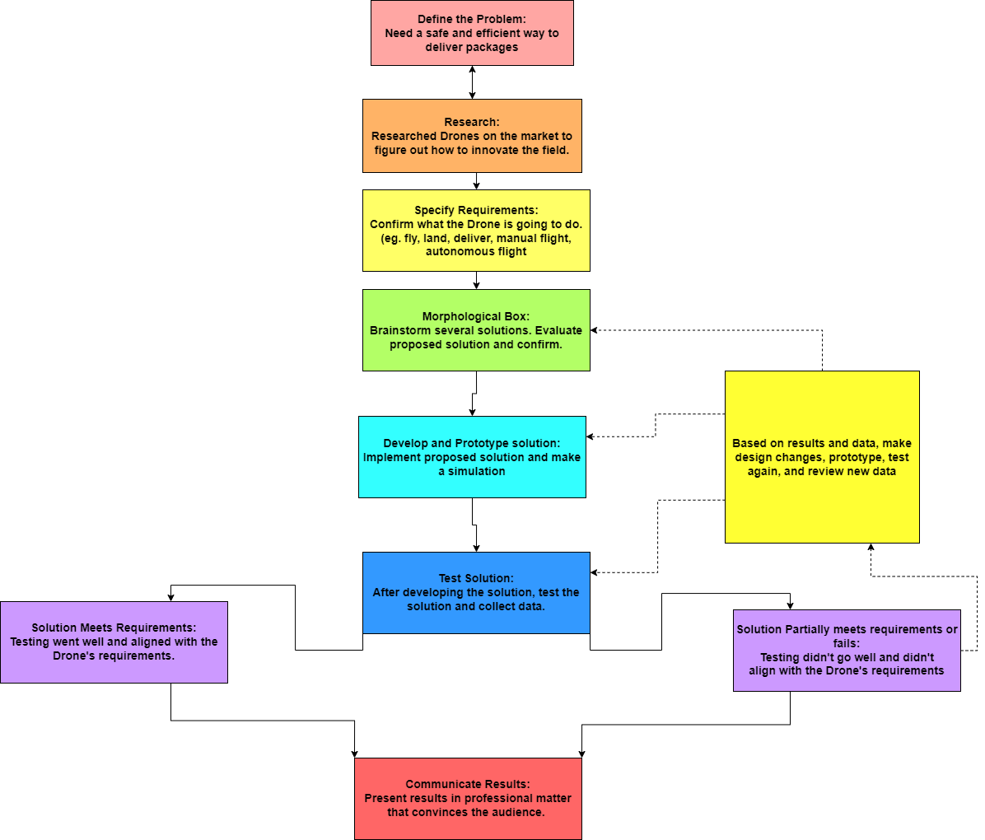
Engineering Process

Slide 11
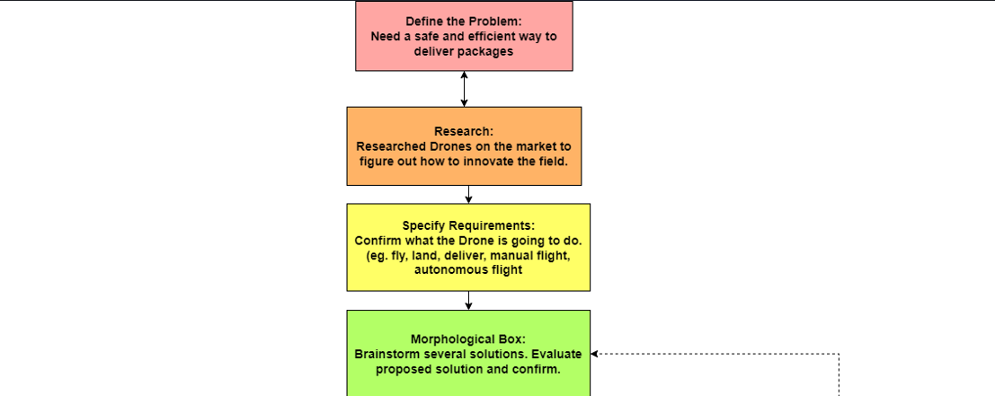
Engineering Process (zoomed in)

Slide 12
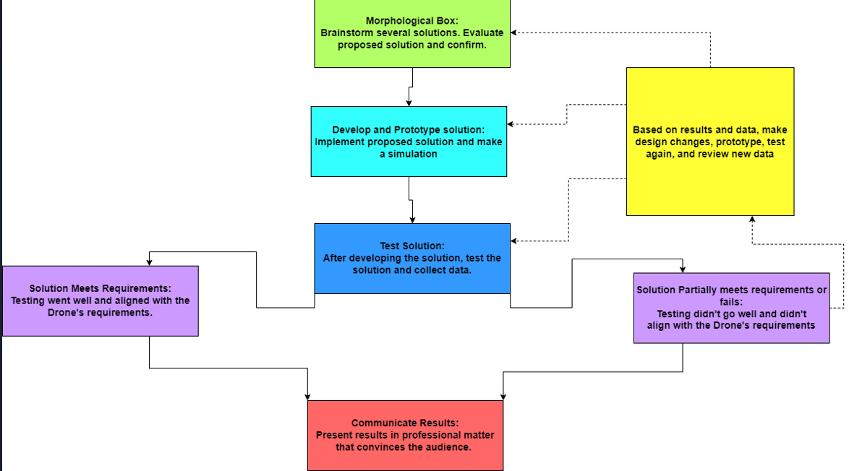
Engineering Process (zoomed in pt2)

Slide 13
Mission Requirements
Drone shall deliver an item to a consumer
Drone shall offer an autonomous delivery option and a manual delivery option. Manual delivery requires the use of a remote control while the autonomous delivery option requires the user to input information into the drone using external device like a laptop.
Drone shall enforce contactless delivery and social distancing practices
Drone shall offer convenience to consumers

Slide 14
System Requirements
Input Requirements
The drone shall accept coordinates for directions
The drone shall accept inputs from remote control
The drone shall accept input to boot up and shut down
Output Requirements
The drone shall fly to destination when coordinates are received
The drone pilot shall send a text message to the customer once their package arrives
The drone shall react according to the inputs from the remote control.
The drone shall turn on when instructed to do so
Functional Requirements
The drone shall be able to carry 300 grams.
The drone shall limit package weight
The drone shall be waterproof/resistant
The drone shall be able to travel within 30 feet of its home base.
The drone shall have a delivery compartment
External Interface
Light indicating that the drone is turned on
The drone shall be accompanied by remote control that has a signal of about 30 feet
Arducam connected to Raspberry Pi for live video feed
Scale to weigh items before flying

Slide 15
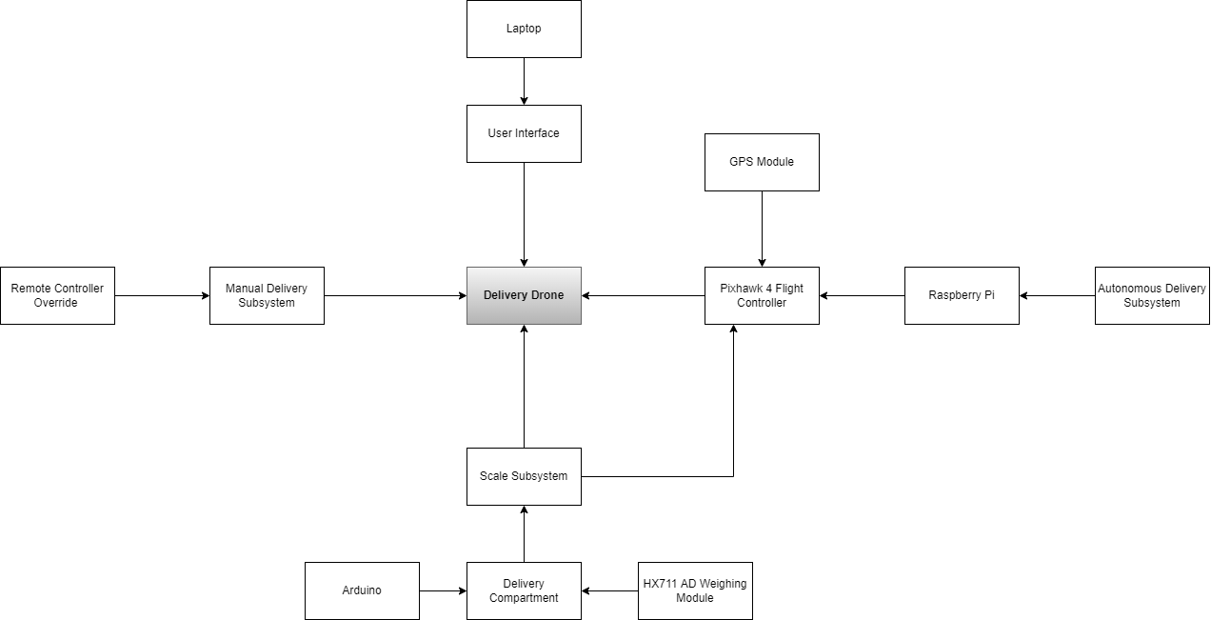
Block Diagram

Slide 16
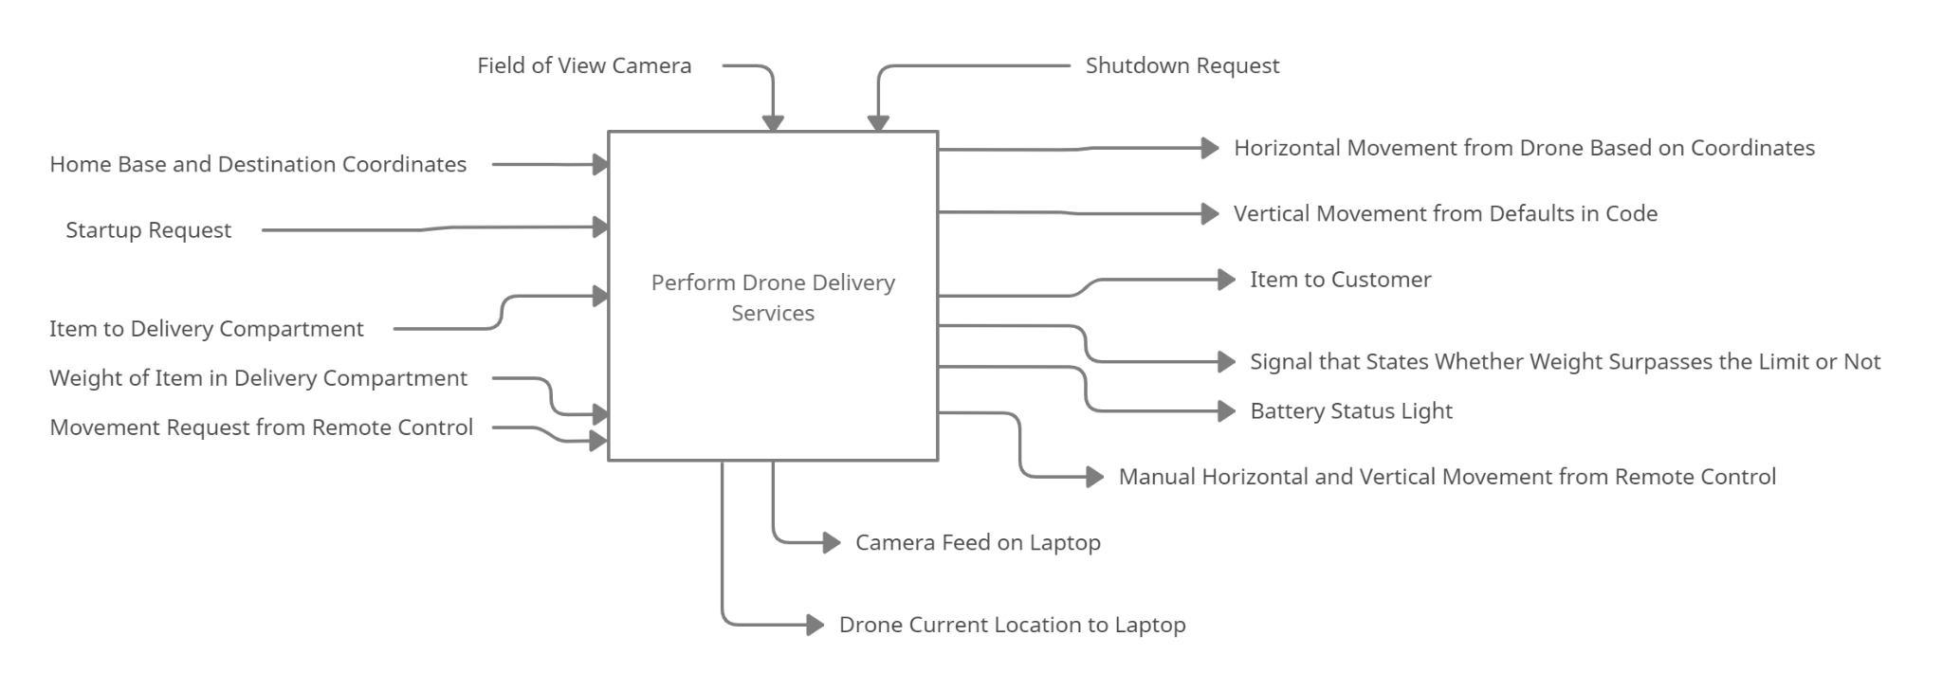
Functional Architecture Input and Outputs

Slide 17
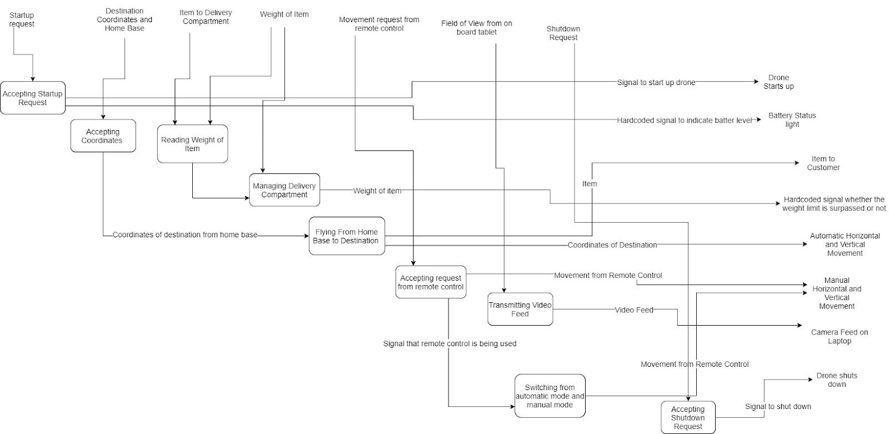
Functional Architecture Tracing Diagram

Slide 18
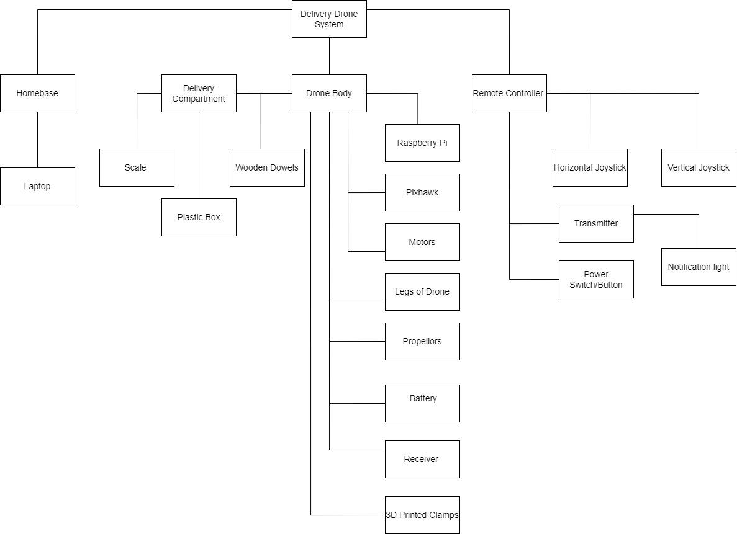
Physical Architecture

Slide 19
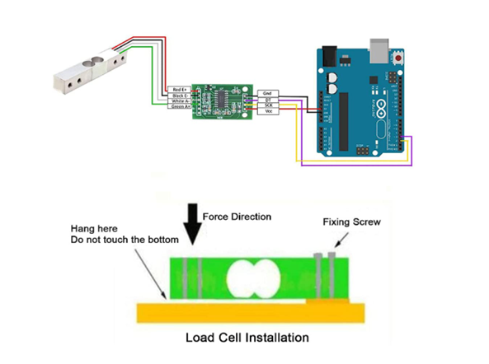
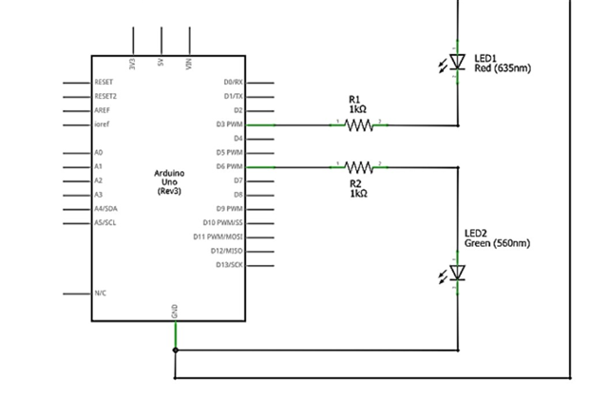
The scale

Slide 20
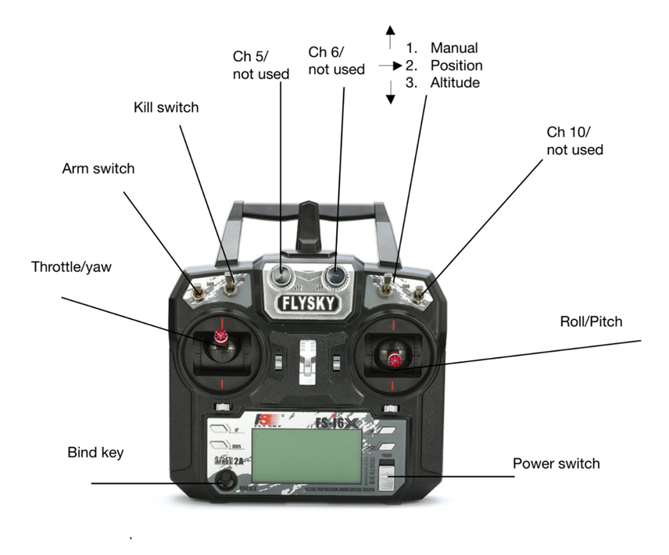
RC Controller

Slide 21
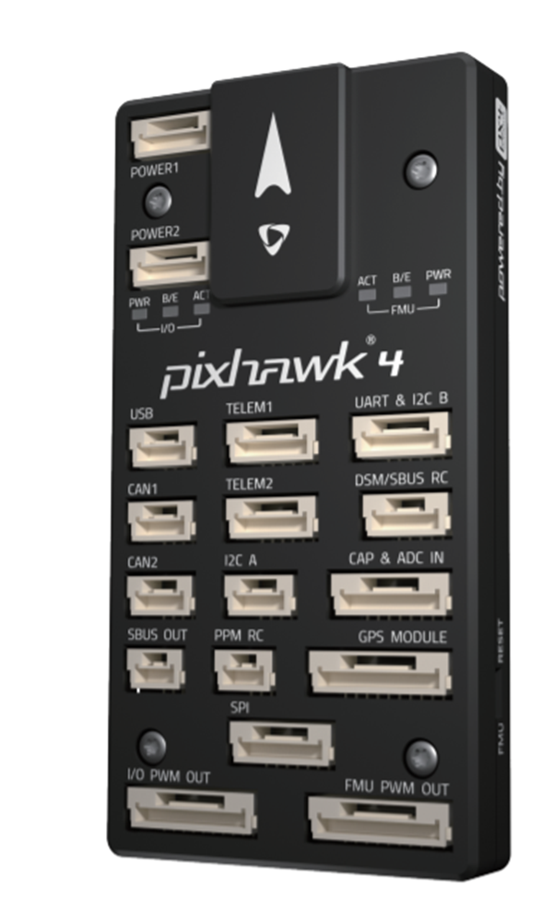
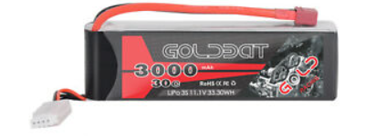
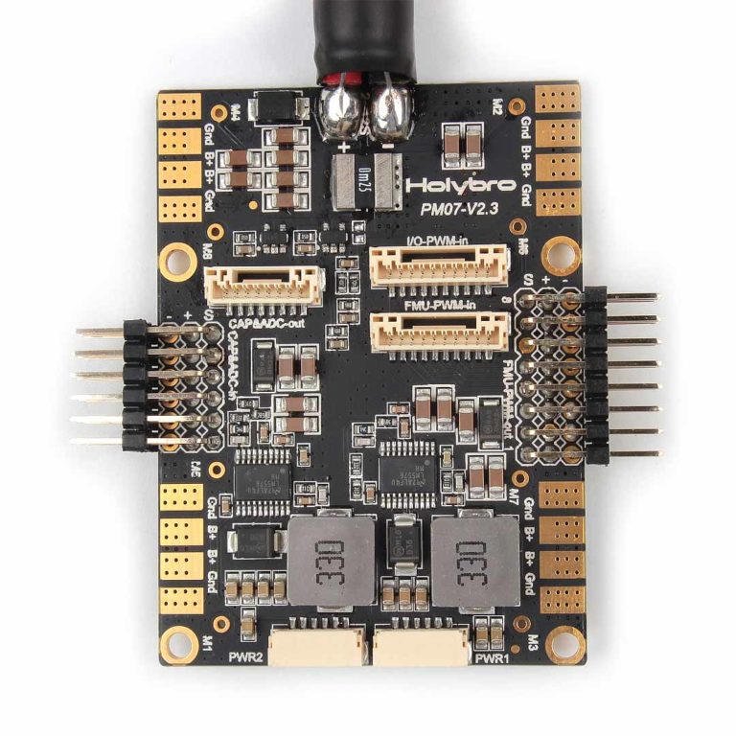
Pixhawk 4
Communication with Raspberry Pi
Receiver
GPS Module

Slide 22
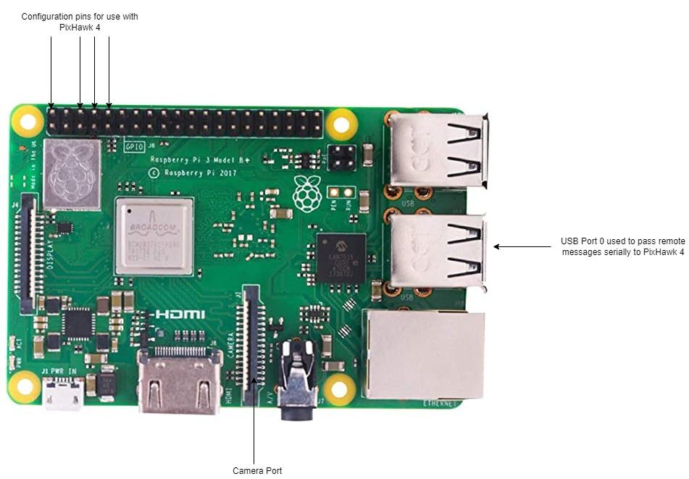
Raspberry Pi

Slide 23
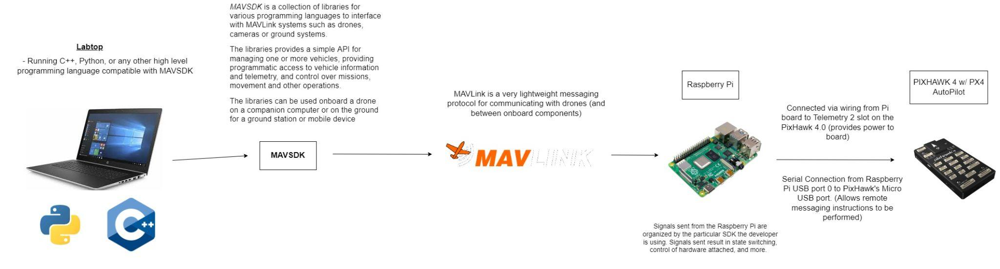
Flight Stack Diagram

Slide 24
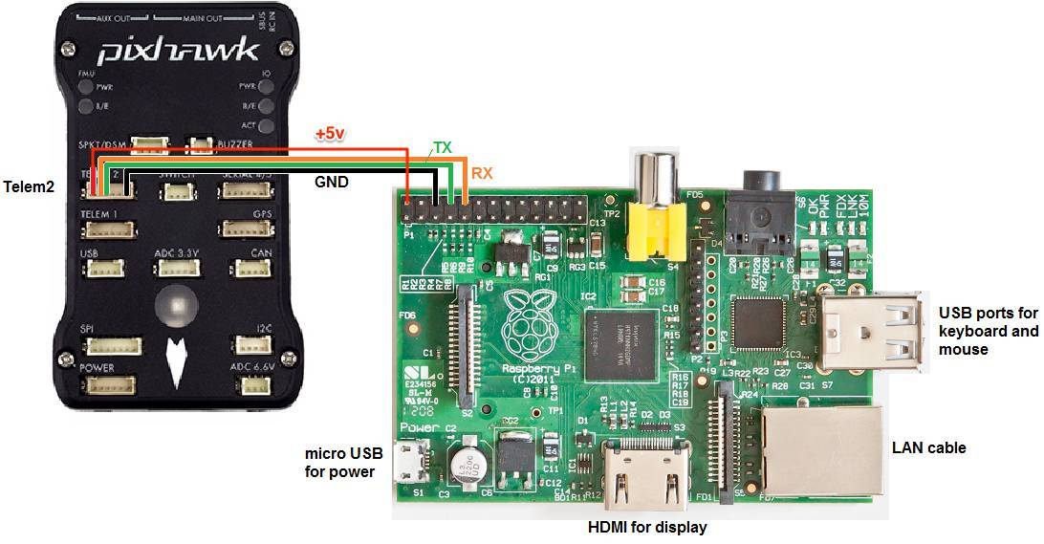
Raspberry Pi to PixHawk 4 Wiring (Power)

Slide 25
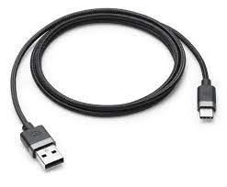
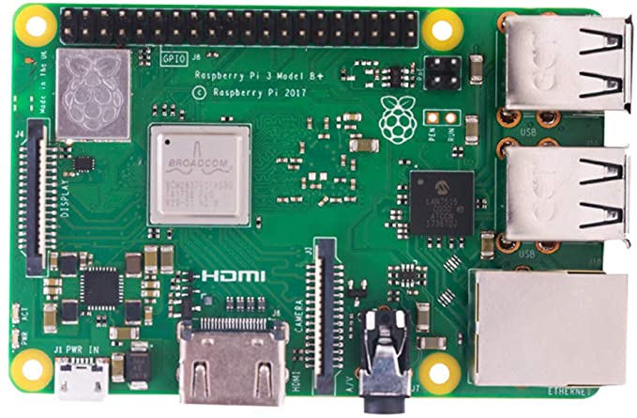
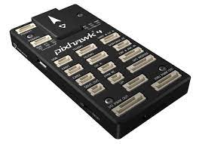
Raspberry Pi to PixHawk 4 Wiring
(Remote Messaging)
Micro USB
USB 2.0

Slide 26
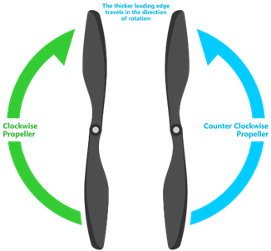
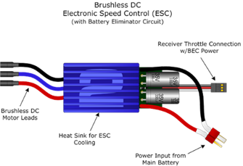
Drone Parts

Slide 27

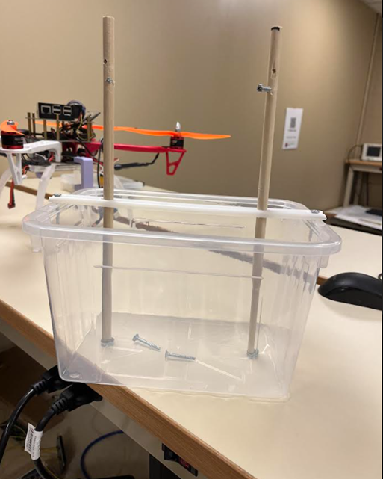

Delivery Compartment

Slide 28
Safety Precautions
Lithium polymer battery
Soldering
Propellers taken off for motor testing
Constructing delivery compartment
Testing conducted in outdoor areas

Slide 29
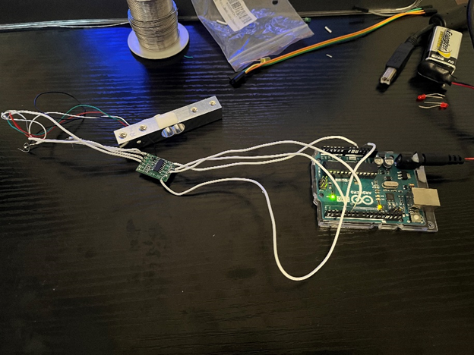
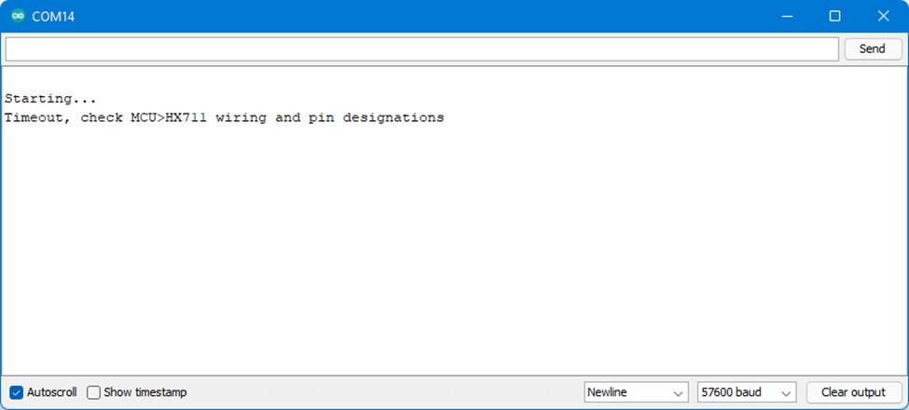
Problems and Hardships
Not testing HX711 module before soldering
Soldering wires before using a multimeter

Slide 30
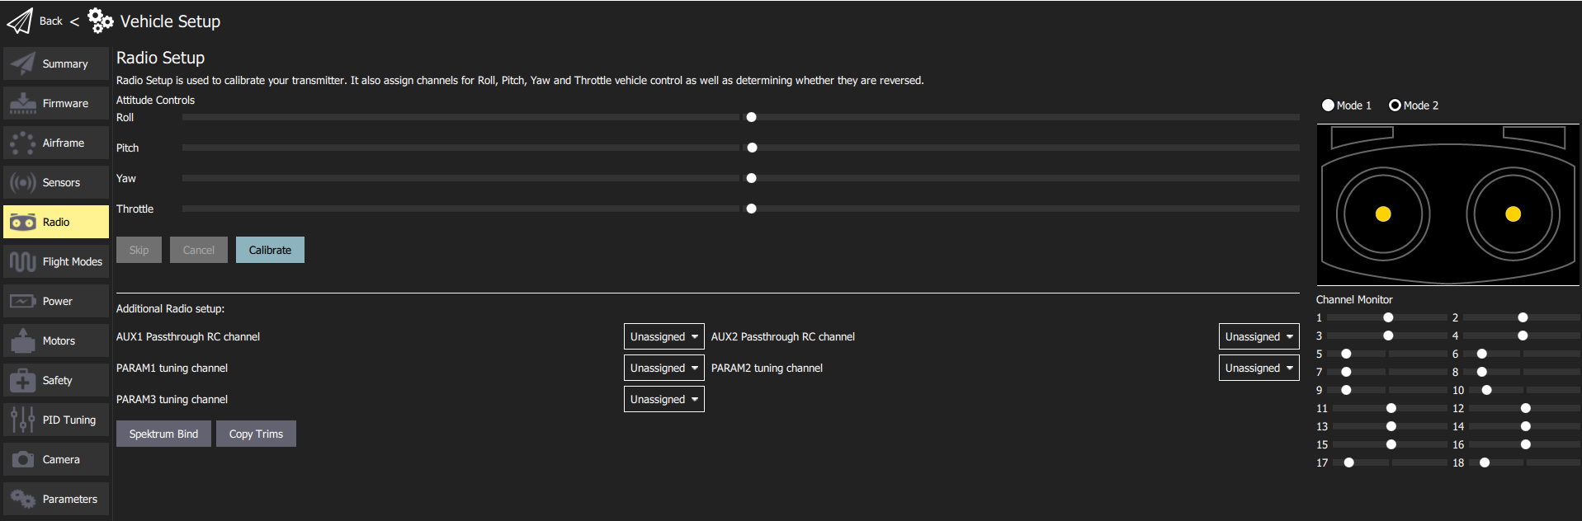
Problems and Hardships (continued…)
Radio channels were not properly configured to be recognized by QGroundControl for calibration
“Detected 0 radio channels. To operate PX4, you need at least 5 channels.”

Slide 31
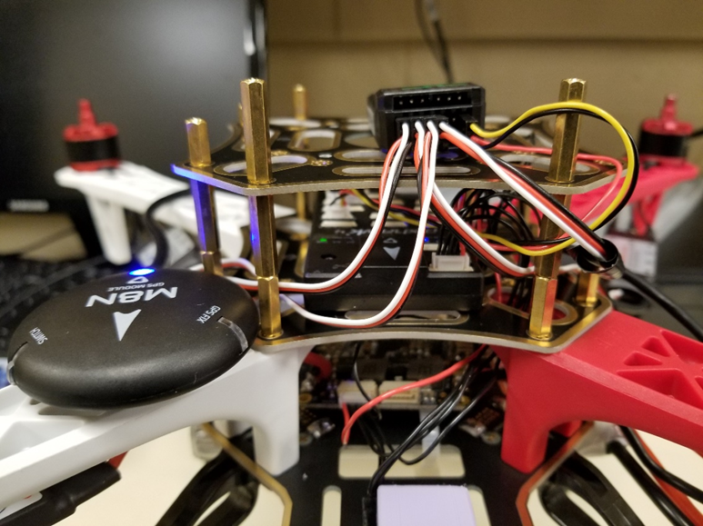
Problems and Hardships (continued…)
Two motors spinning rather than four when throttle was increased
Electronic Speed Controllers plugged into receiver channels rather than power module
Moved to power module board

Slide 32

Problems and Hardships (continued…)
Motors at this point were spinning at different speeds
Fixed using QGroundControl ESC calibration (calibrates battery output)
Autonomous functionality does not always work on a secured network like Lewis University
Camera component had to be removed as it created problems operating the drone autonomously

Slide 33
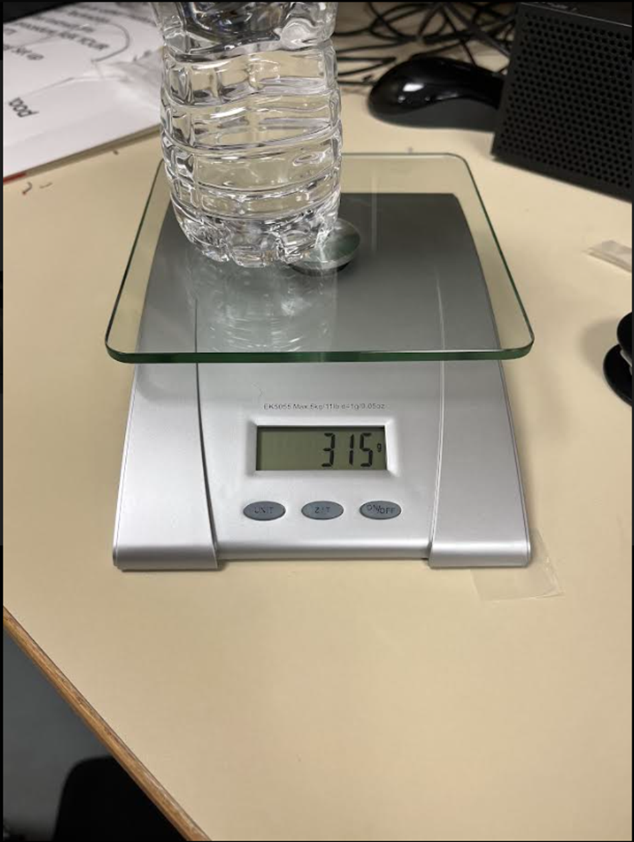
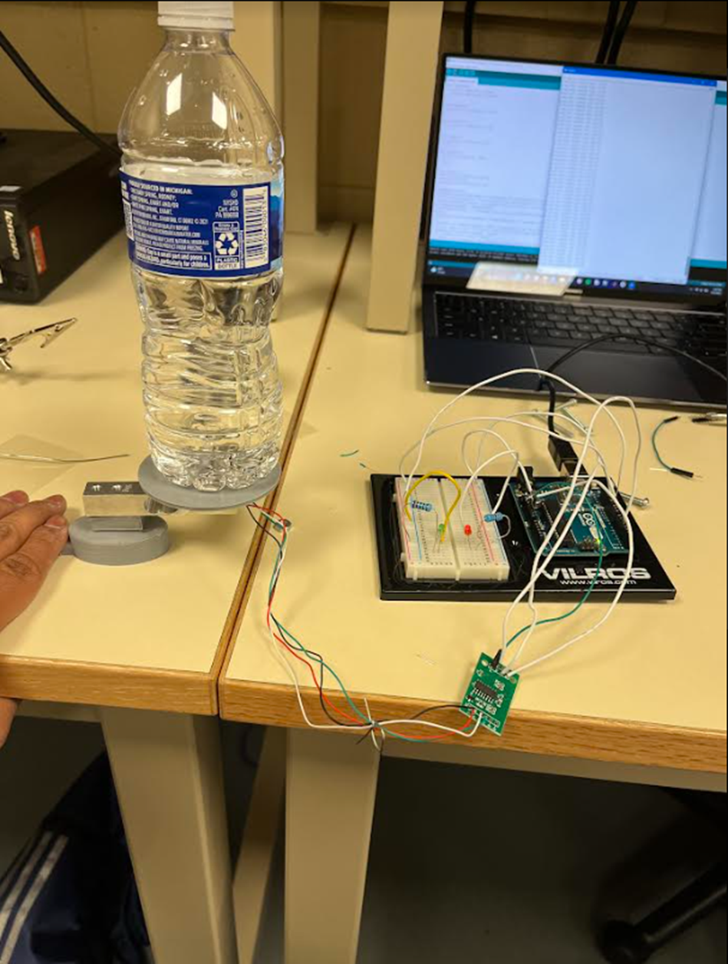
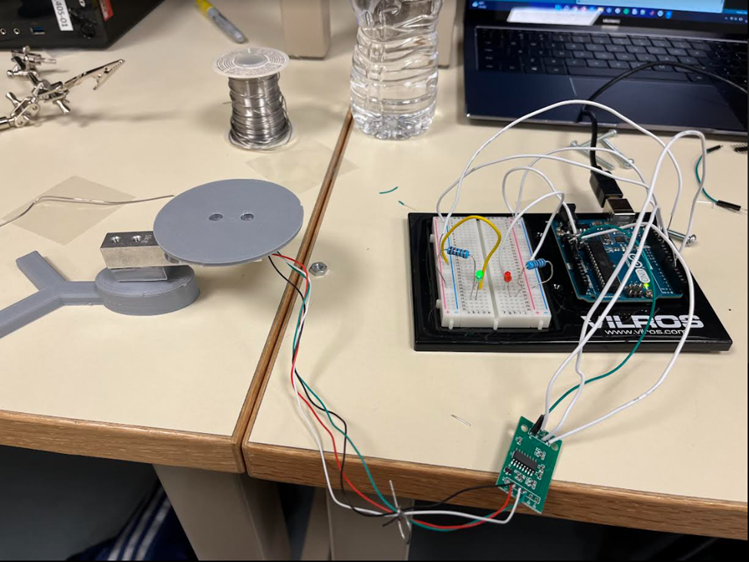
Testing

Slide 34
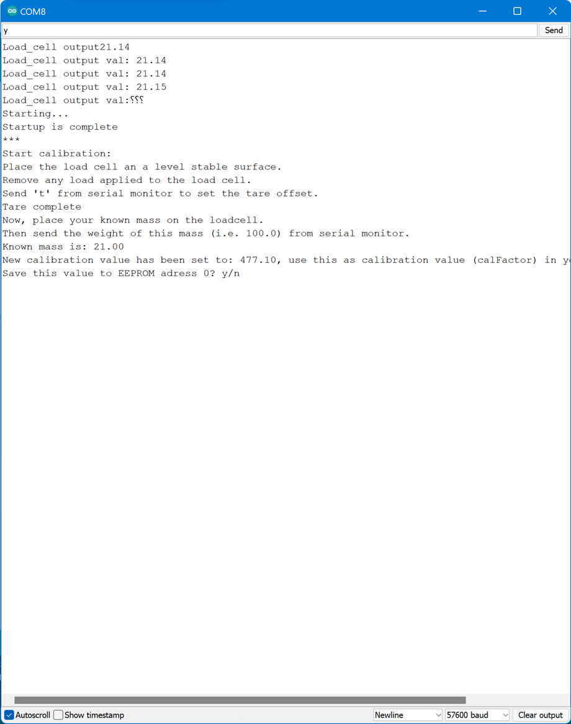
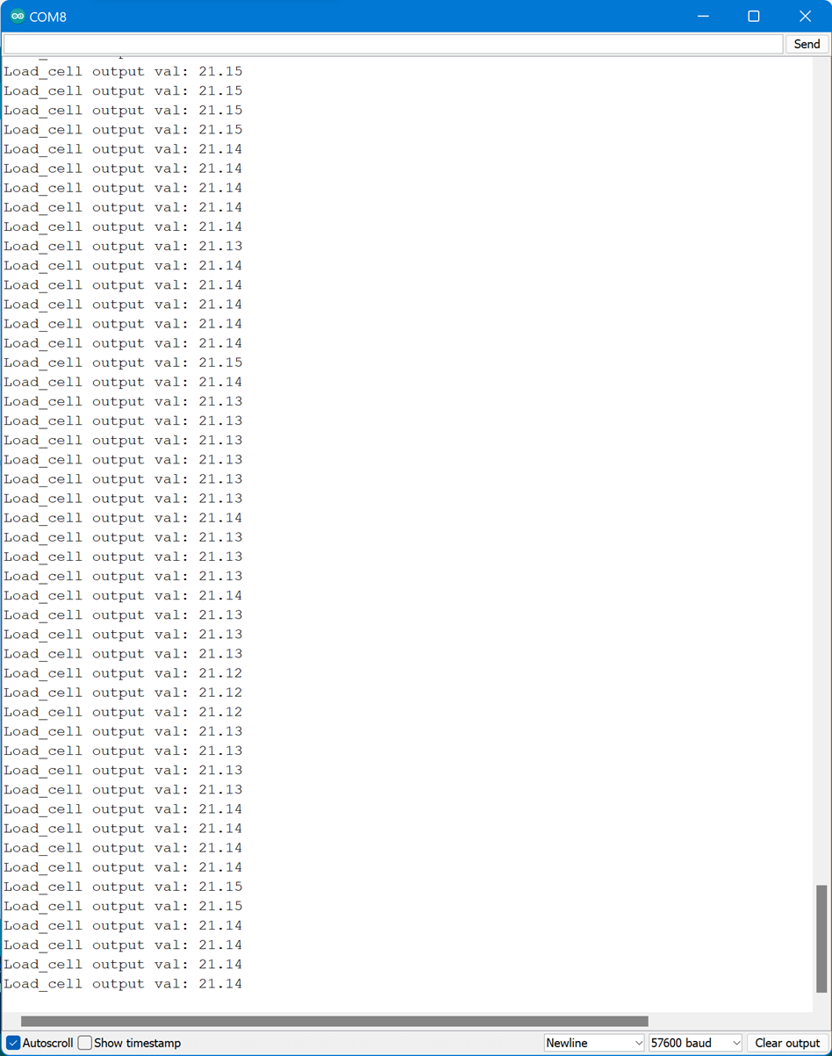
Testing (continued…)

Slide 35
Testing (continued…)
Testing plan begins with pre-flight checks
Check motor speed and direction
Drone placed in open area
Drone powered on then placed in manual mode
Takeoff and land

Slide 36
Test Flight 1
Pre-flight checks successful
Motor speeds and orientations checked
Drone armed and propellers began spinning
Drone flipped over

Slide 37

Test Flight 1

Slide 38
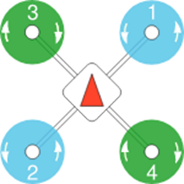
Solution to Test Flight 1 Errors
Drone flipped over due to motor orientation not exactly matching PX4 airframe reference
Motors rotated counterclockwise to match PX4 diagram

Slide 39
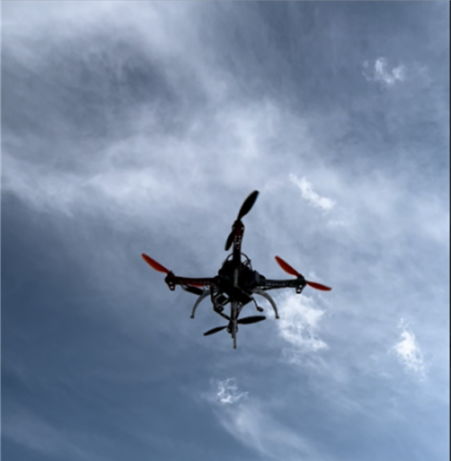
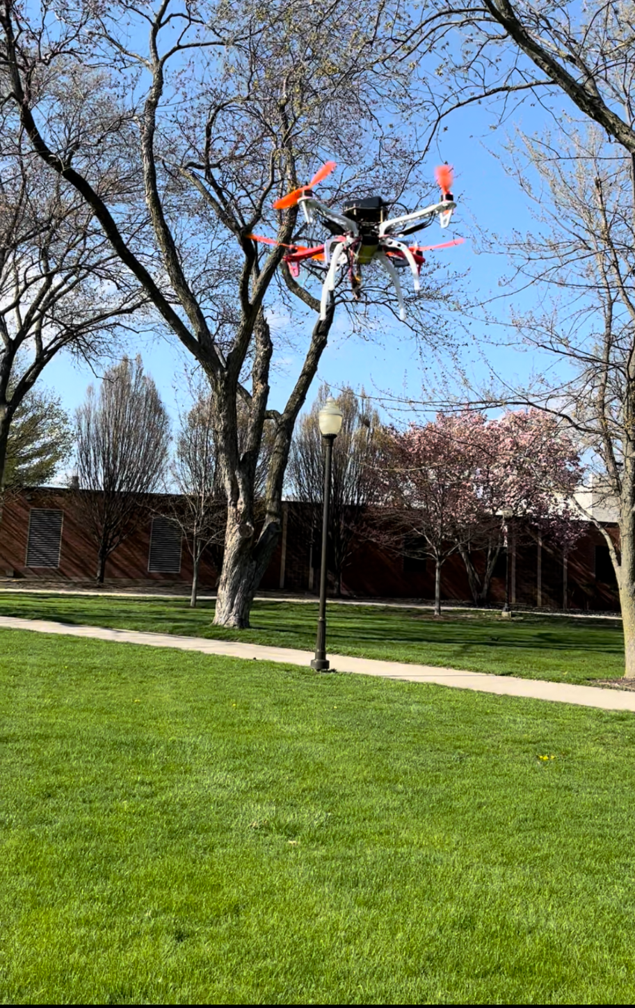
Test Flight 2

Slide 40
Test flight for Autonomous Function
Pre-flight checks successful
Drone taken to open area
Drone powered on and armed
Python script run on laptop
Takeoff and land scenario

Slide 41
Autonomous Functionality Video

Slide 42
Results
Drone is able to fly with Automatic mode, for take off and landing
Drone is able to be fly in Manual mode, however it is difficult to control with very limited time for testing
Scale works well with 0.05% of error
Unsuccessful flight with delivery compartment

Slide 43
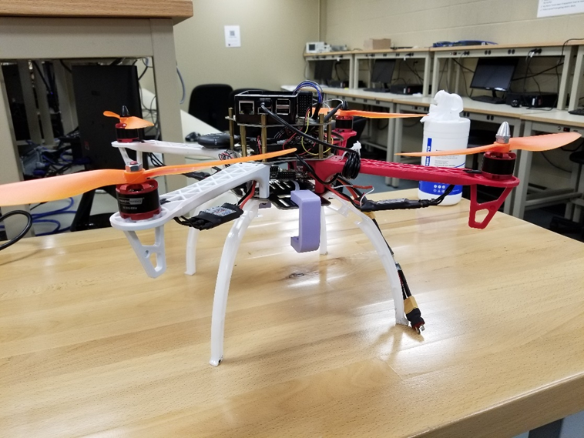
Conclusion
Goal was to build a system to enforce contactless delivery
Built from custom parts to be more affordable
Delivery compartment failed
Properly working scale
Manual and autonomous flight functionalities
Separate subsystems

Slide 44
Future Work
New delivery compartment design
Implementation of a camera for use with manual controls
Collision detection
Advanced automated scripts
Planned missions
Route changing

Slide 45
Demonstrations
Scale
Manual Mode
Automatic take off and land function

Slide 46
References
[1] “COVID-19 Healthcare Delivery Impacts.” asprtracie.hhs.gov. https://files.asprtracie.hhs.gov/documents/covid-19-healthcare-delivery-impacts-quick-sheet.pdf (accessed Feb. 18, 2022).
[2] “How to Protect Yourself & Others.” cdc.gov. https://www.cdc.gov/coronavirus/2019-ncov/prevent-getting-sick/prevention.html#:~:text=Stay%206%20feet%20away%20from,sick%20and%20other%20household%20members (accessed May 4, 2022).
[3] https://standards.ieee.org/standard/ (accessed May 4, 2022).
[4] “Ethical issues with use of drone aircraft - cs-CSIF.” [Online]. Available: https://csiflabs.cs.ucdavis.edu/~ssdavis/188/Ethical%20Issues%20with%20use%20of%20Drone%20Aircraft.pdf. [Accessed: 04-Feb-2022].

Slide 47
References
[5] “IEEE standards activities for intelligent transportation ...” [Online]. Available: https://standards-dev21.ieee.org/wp-content/uploads/import/documents/other/its.pdf. [Accessed: 03-Feb-2022].
[6] “Why is manual flight important?,” DroneDeploy, 05-Dec-2019. [Online]. Available: https://www.dronedeploy.com/blog/benefits-dronedeploy-manual-flight/. [Accessed: 24-Mar-2022].
[7] Battery University, “BU-808: How to prolong lithium-based batteries,” Battery University, 03-Dec-2021. [Online]. Available: https://batteryuniversity.com/article/bu-808-how-to-prolong-lithium-based-batteries. [Accessed: 03-Feb-2022].
[8] “Capturing requirements,” System requirements in systems engineering with Rational Rhapsody. [Online]. Available: https://www.ibm.com/docs/en/rhapsody/8.3.1?topic=analysis-obtaining-system-requirements. [Accessed: 02-May-2022].

